Slide 1
Clearing and Settlement

Tarmiden Sitorus
Deputy Director
Bank Indonesia
Conference on Development of Indonesian Government Bond Market
July 25-26 2000
Jakarta, Indonesia

Slide 2
Introduction
Benefits
Overview of the clearing and settlement process
The BI-SKRIP system
Concluding Remarks

Slide 3
Benefits from efficient clearing and settlement
Timely and reliable settlement of government bond trades
Minimal risk to participants in case of institutional failure
Minimal risk to system operator(s)
Market confidence in the infrastructure

Slide 4
Part I:
Overview of the clearing and settlement process
“Standard” Model
International Standards and Guidelines
Risks

Slide 5
Clearing & settlement process
Matching the terms of trade (confirmation)
Calculation of obligations (clearing)
Discharge of the obligations (settlement)
Transfer of securities (delivery)
Transfer of funds (payment)

Slide 6

Delivery versus Payment
The transaction will only be finalised (settled) if:
  the Securities can be delivered
  the Payment can be made
at the same time

Slide 7
Bank for International Settlements – Core Principles
Well founded legal basis
Rules and procedures should be clear
Management of credit and liquidity risks should be clearly defined
Final settlement before end of day
Timely completion of multilateral settlements
Settlement assets should be a claim on the central bank
System should be secure and reliable
System should be practical and efficient
Access criteria should be objective and public
Effective and transparent governance arrangements

Slide 8
BIS/IOSCO: Disclosure Framework
Basic Information
Rules and Procedures
Relationships with Participants
Relationship with other Securities Settlement Systems
Securities transfers, funds transfers and linkages
Default procedures
Securities overdrafts, securities lending and back-to-back transactions
Risk control measures
Operational risks

Slide 9
Risks
Credit Risk: A counterparty does not settle an obligation
Replacement risk: Market loss on an undelivered security
Principal risk: Loss of security
Liquidity risk: Delay in settlement date due to funding
Systemic risk: “Domino effect” whereby settlement failure cause other participants to fail
Legal Risk: Claims in law are unclear or may not be upheld (legal risk)
Operational Risk: The system breaks down

Slide 10
Part II:
The BI-SKRIP system
Architecture
Clearing and Settlement Examples:
  Free of Payment
  Delivery v Payment

Slide 11
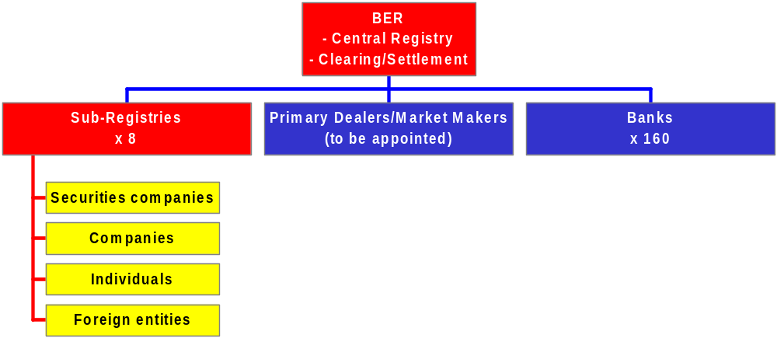
Architecture – Institutional Membership
BI-SKRIP
BER = Book Entry Registry
(operated by Bank Indonesia)

Slide 12
Sub-Registries
Must be established under Indonesian law
Must not be in bankruptcy, or the threat thereof
Three years experience and Rp1 trillion of other securities in custody
Suitable business networks
Safe, reliable and trusted scripless registry system
Qualified and capable management and staff
Financially sound
Government bond registry activities are supervised by Bank Indonesia.

Slide 13

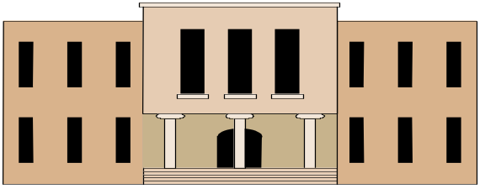
“Free of Payment” Process
Payment (if any) takes place outside BI-SKRIP
Selling
Investor
Selling
Broker/Bank
Buying
Broker/Bank
Buying
Investor
Fixed Income Market
OTC or BES
FOP Securities
Transfer Form
(SPPR)
Statement
of Account
BI-SKRIP
Donor/
Legator
Beneficiary
Seller’s
Sub-Registry
Buyer’s
Sub-Registry
BER
☑
Securities Transfer

Slide 14


“Delivery Versus Payment” Process
Selling
Investor
Selling
Broker/Bank
Buying
Broker/Bank
Buying
Investor
DVP Securities
Transfer Form
(SPPR)
Fixed Income Market
OTC or BES
Statement
of Account
DVP Payment
Order
(SPPP)
Bank
Statement
BI-SKRIP
Seller’s Bank
Seller’s
Sub-Registry
Buyer’s
Sub-Registry
Buyer’s Bank
BER
☑
DVP Settlement
Payment
Securities Transfer

Slide 15
Example of foreign trade with DVP
Selling
Investor
Selling
Broker/Bank
Buying
Broker/Bank
Buying
Investor
London OTC Market
BI-SKRIP
Deutsche Bank
ABN Amro
Citibank
HSBC
BER
☑
DVP Settlement
Payment
Securities Transfer

Slide 16
Example of domestic trade with other payment method
Selling
Investor
Selling
Broker/Bank
Buying
Broker/Bank
Buying
Investor
Fixed Income Market
OTC or BES
BI-SKRIP
KSEI
Bank Niaga
Bank Internasional
Indonesia
BER
☑
DVP Settlement
Payment
Securities Transfer

Slide 17
Integration with Real Time Gross Settlement (RTGS)
Selling
Investor
Buying
Investor
DVP Securities
Transfer Form
(SPPR)
Statement
of Account
Bank
Statement
BI-SKRIP
DVP Payment
Order
(SPPP)
Seller’s
Sub-Registry
Buyer’s
Sub-Registry
BER
Seller’s Bank
Buyer’s Bank
☑
RTGS DVP
Payment Order
DVP Settlement
RTGS
Payment
Securities Transfer

